Slide 1
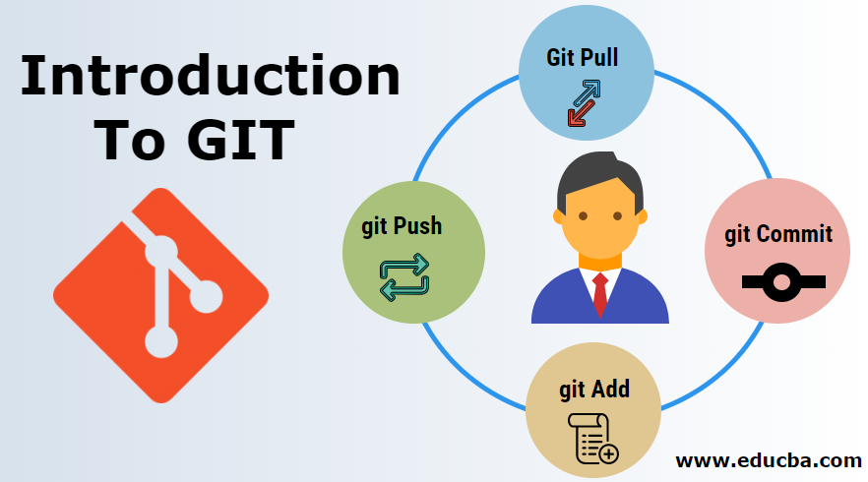
By
Megha Gupta
A version Controller

Slide 2
What is Git
Git is a popular version control system.
It was created by Linus Torvalds in 2005 and has been maintained by Junio Hamano since then.
It is used for:
Tracking code changes
Tracking who made changes
Coding collaboration

Slide 3
Why do we use git
Manage projects with Repositories
Clone a project to work on a local copy
Control and track changes with Staging and Committing
Branch and Merge to allow for work on different parts and versions of a project
Pull the latest version of the project to a local copy
Push local updates to the main project

Slide 4
Why GIT
Over 70% of developers use Git!
Developers can work together from anywhere in the world.
Developers can see the full history of the project.
Developers can revert to earlier versions of a project.
Developers can make a clone of the repository before the final commit.

Slide 5
What is GitHub
Git is not the same as GitHub.
GitHub makes tools that use Git.
GitHub is the largest host of source code in the world and has been owned by Microsoft since 2018.
Today, we will focus on using Git with GitHub.
There are other platforms:
Bitbucket
GitLab

Slide 6
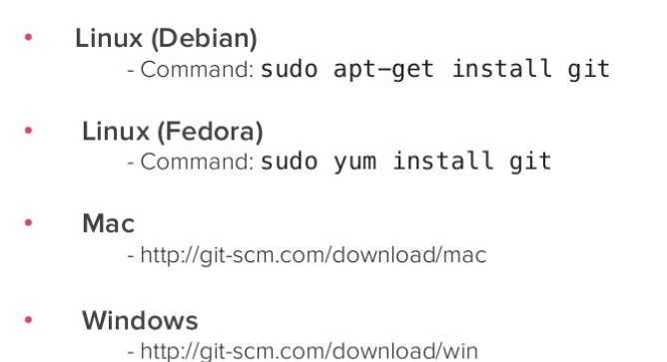
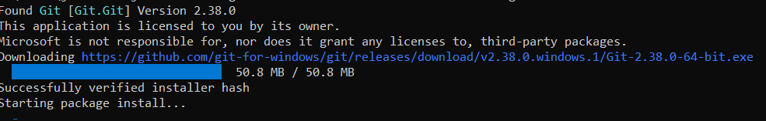
Install git
Windows
winget install --id Git.Git -e --source winget

Slide 7
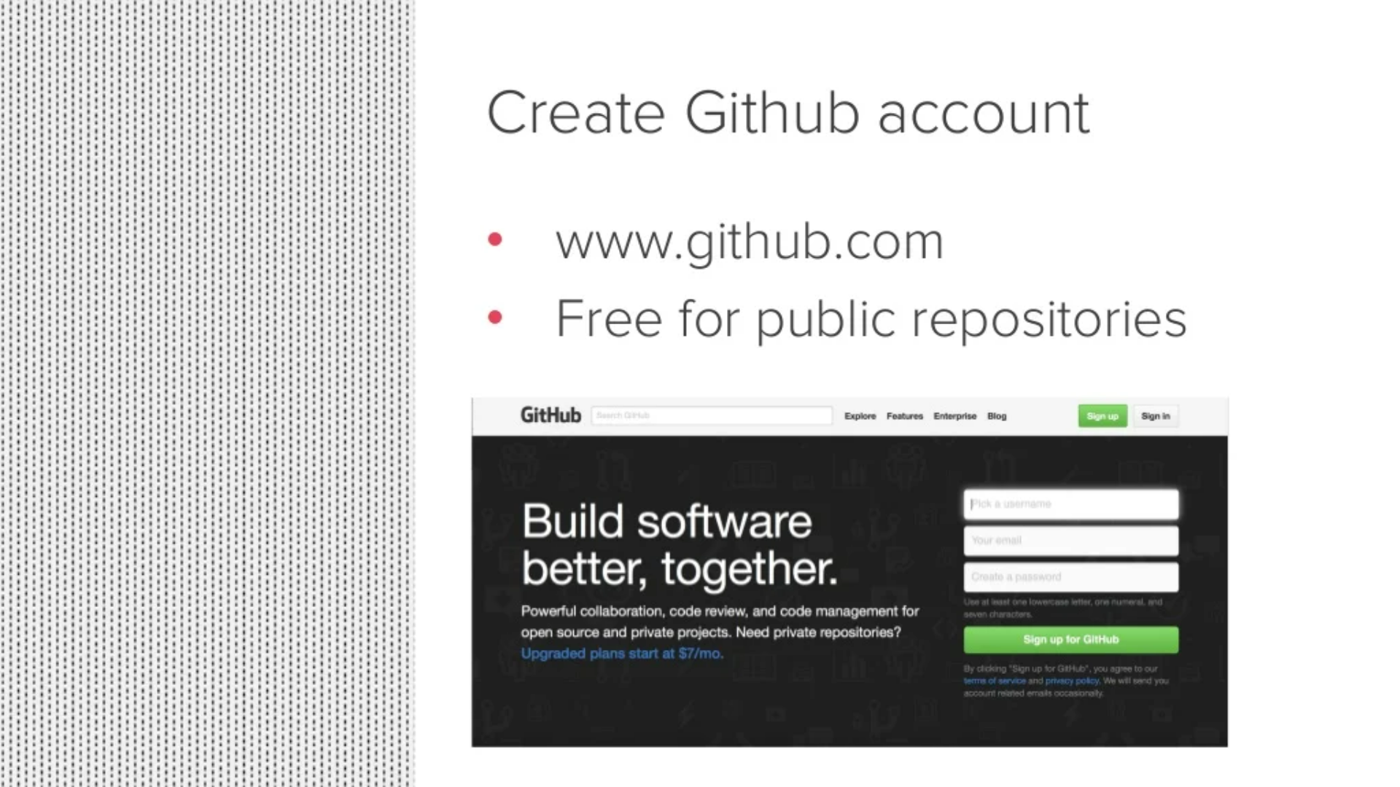
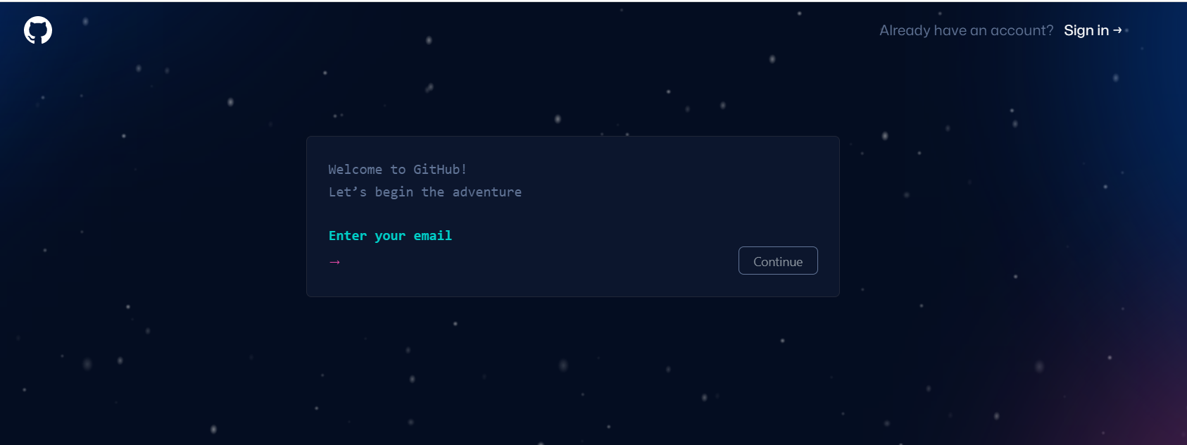
Create or Use github

Slide 8

GIT pull
The git pull command is used to fetch and download content from a remote repository and immediately update the local repository to match that content.
Merging remote upstream changes into your local repository is a common task in Git-based collaboration workflows.
git pull [Repository Link]
This command fetches and merges changes on the remote server to your working directory.

Slide 9
GIT add
The git add command adds a change in the working directory to the staging area.
It tells Git that you want to include updates to a particular file in the next commit.
However, git add doesn't really affect the repository in any significant way—changes are not actually recorded until you run git commit.

Slide 10
GIT commit
The git pull command is used to fetch and download content from a remote repository and immediately update the local repository to match that content.
Merging remote upstream changes into your local repository is a common task in Git-based collaboration workflows.

Slide 11
GIT push
The git pull command is used to fetch and download content from a remote repository and immediately update the local repository to match that content.
Merging remote upstream changes into your local repository is a common task in Git-based collaboration workflows.

Slide 12
Stablish new repositories
echo "# DemoRepo" >> README.md
git init git add README.md
git commit -m "first commit"
git branch -M main
git remote add origin git@github.com:JiveshSarkar/DemoRepo.git
git remote add origin https://github.com/JiveshSarkar/DemoRepo.git
git push -u origin main

Slide 13
push an existing repository
git remote add origin git@github.com:JiveshSarkar/DemoRepo.git
git branch -M main
git push -u origin main

